Slide 1
Cinephiles
A place for Movie Freaks

Slide 2
Short Description:
Cinephiles is a website where people basically can become friends with each other and watch movies together. Also they can write reviews and communicate with friends and see friends activity with privacy.

Slide 3
Features
-Movie recommendation.
-User Profile: Watchlist, Recent Watch List.
-Privacy Control Feature
-Chat With Friends
-Posting About Movies on user timeline
-Streaming Movies
-Watch Party With Live Chat
-Movie Review
-Meme Contest & Meme sharing based on movies
-Meme Generator Using API

Slide 4






Language

Slide 5
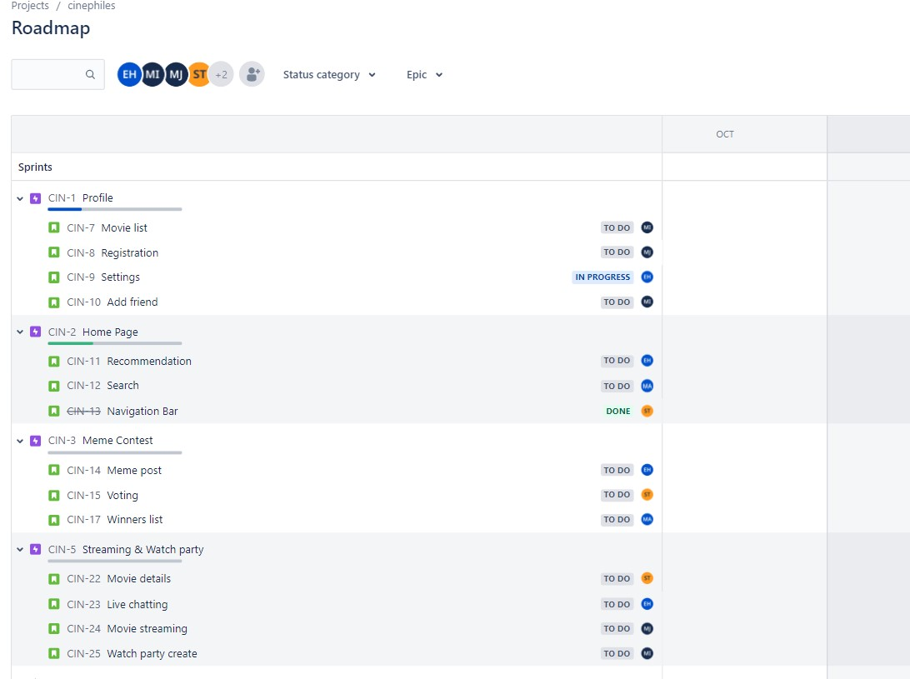
Backlog

Slide 6
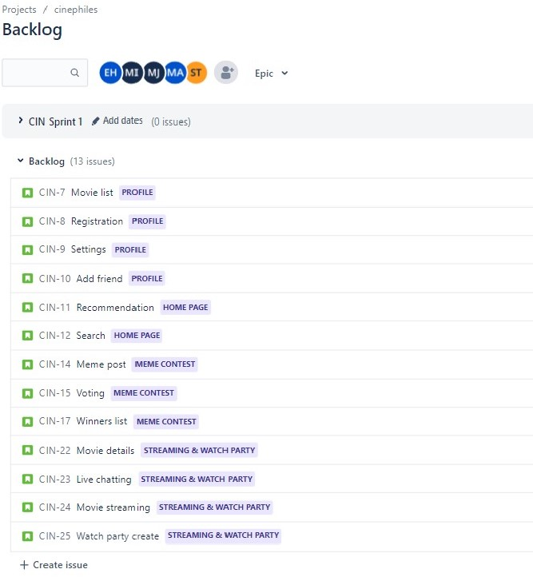
Backlog

Slide 7
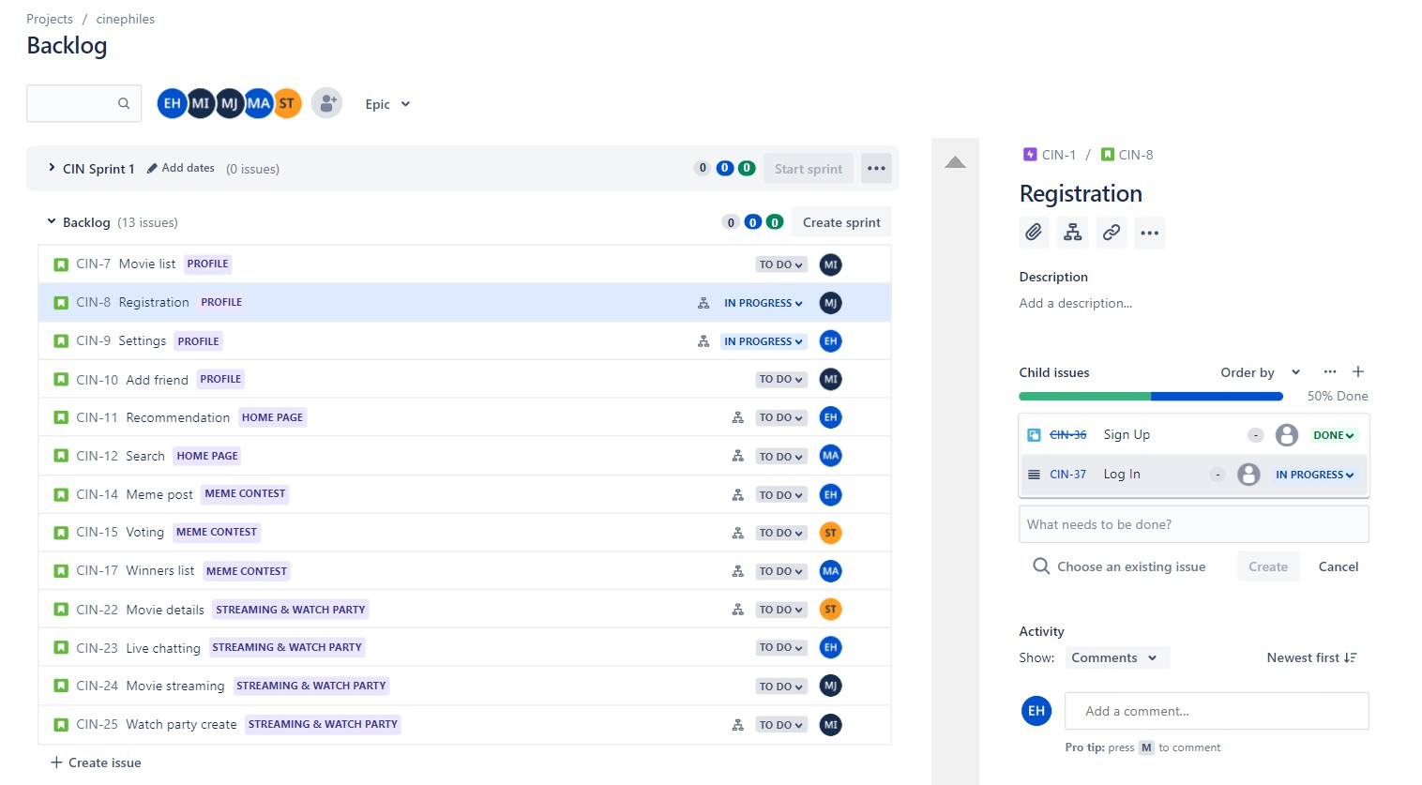
Backlog

Slide 8
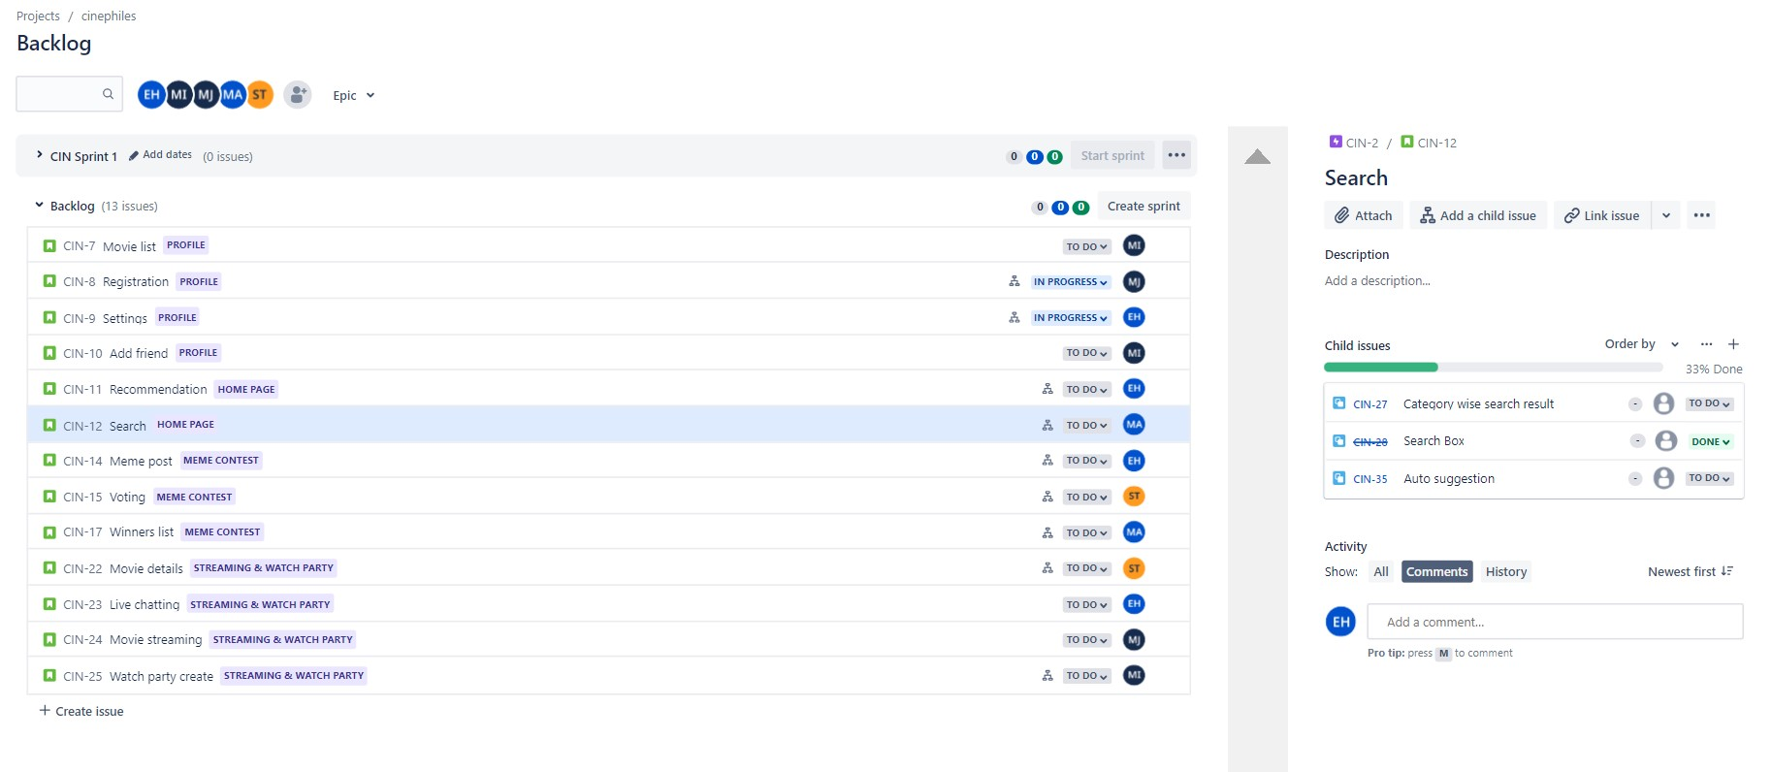
Backlog

Slide 9
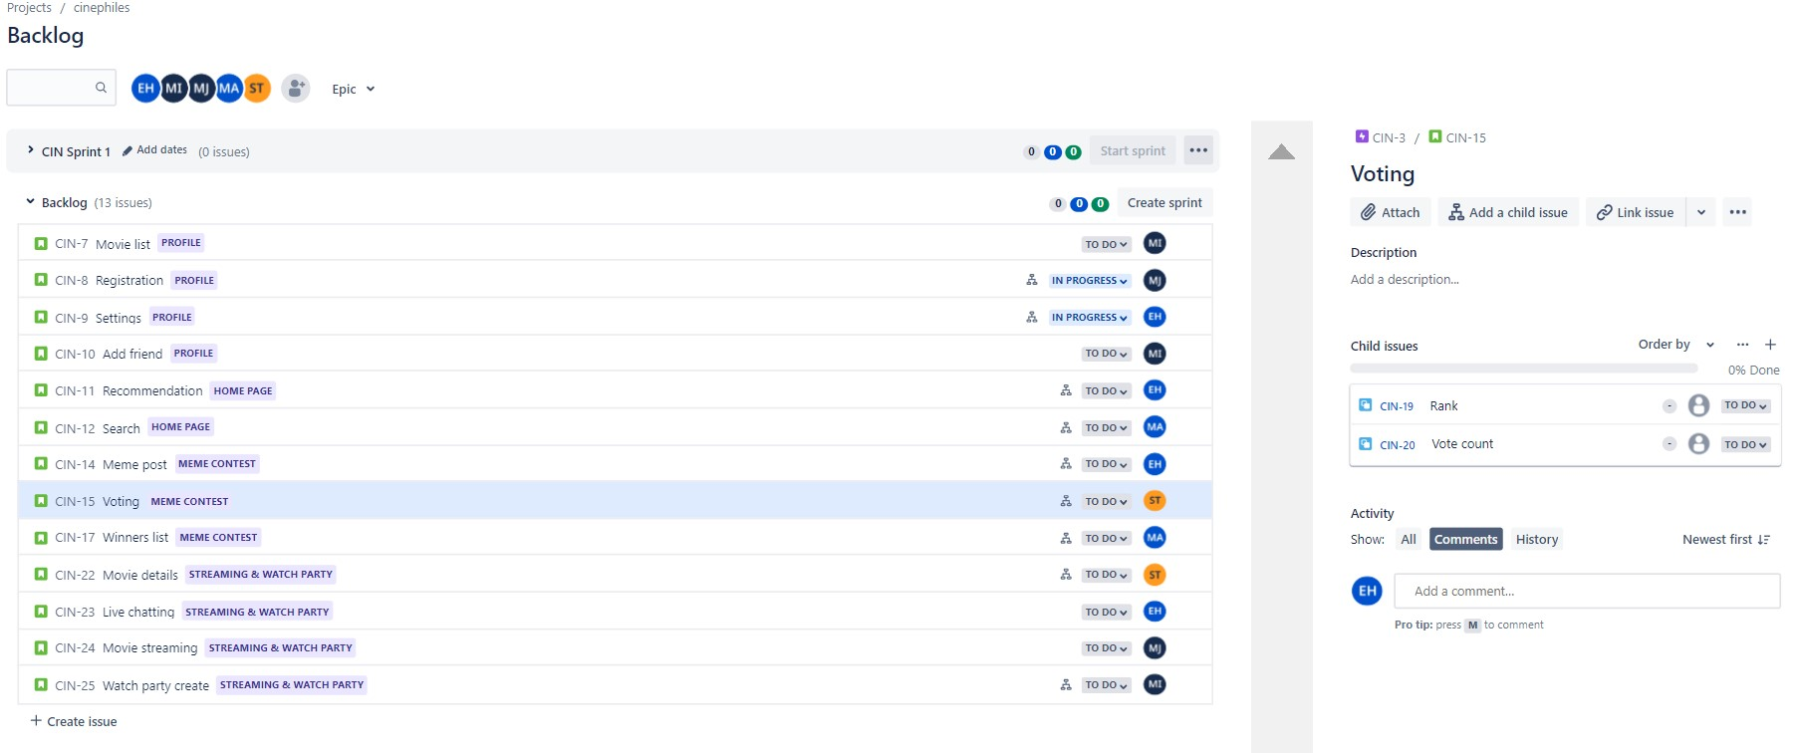
Backlog

Slide 10
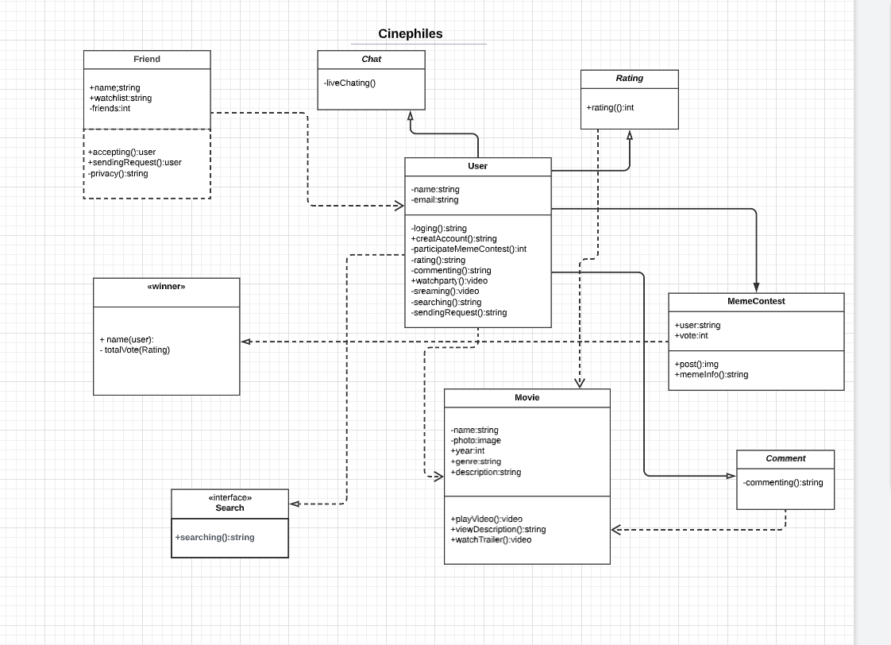
UML Class Diagram

Slide 11
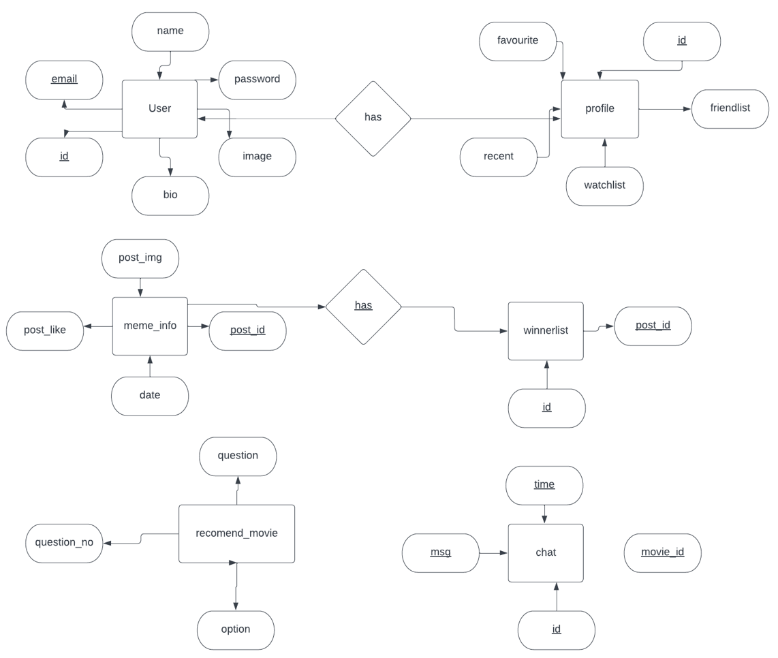
ERD Diagram

Slide 12
Thanks

